Slide 1

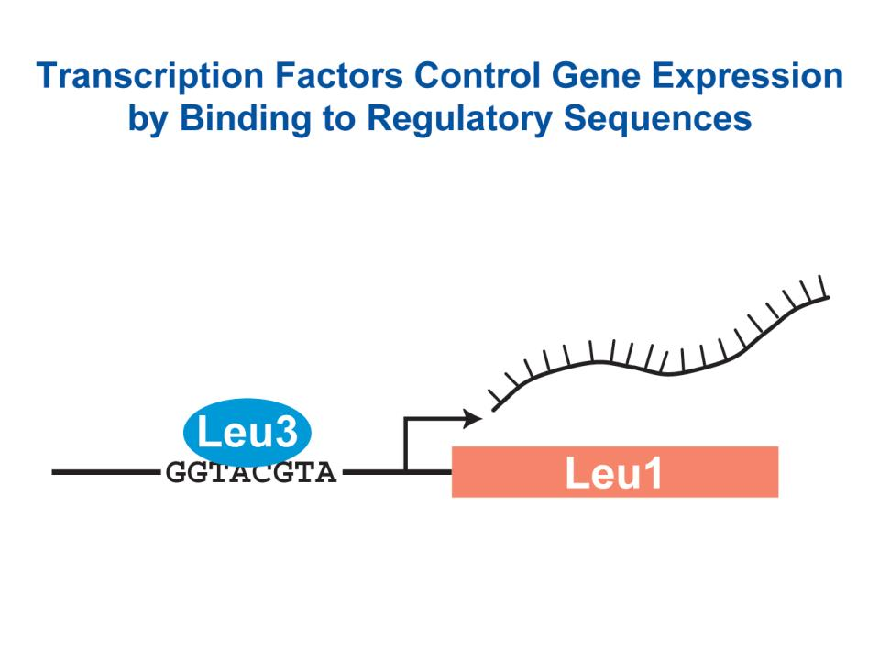
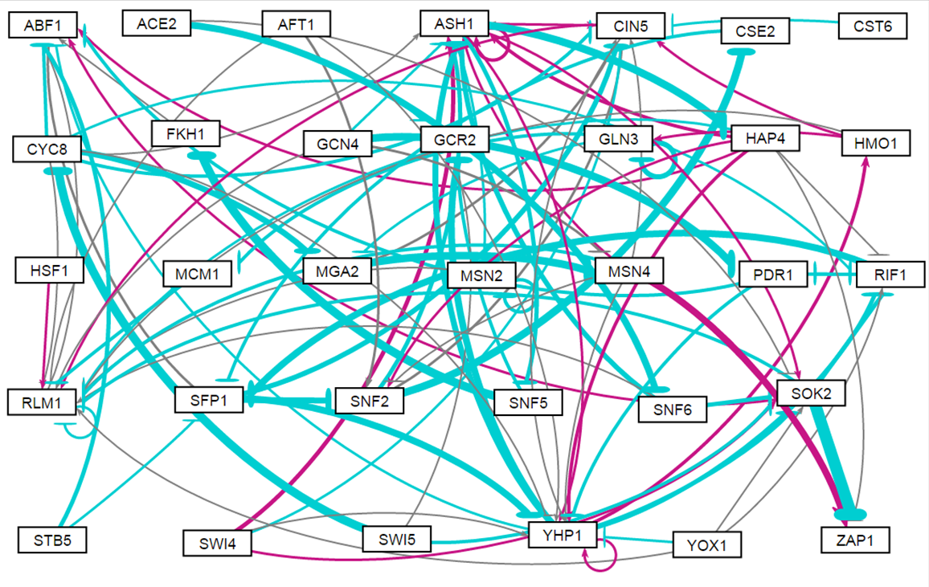
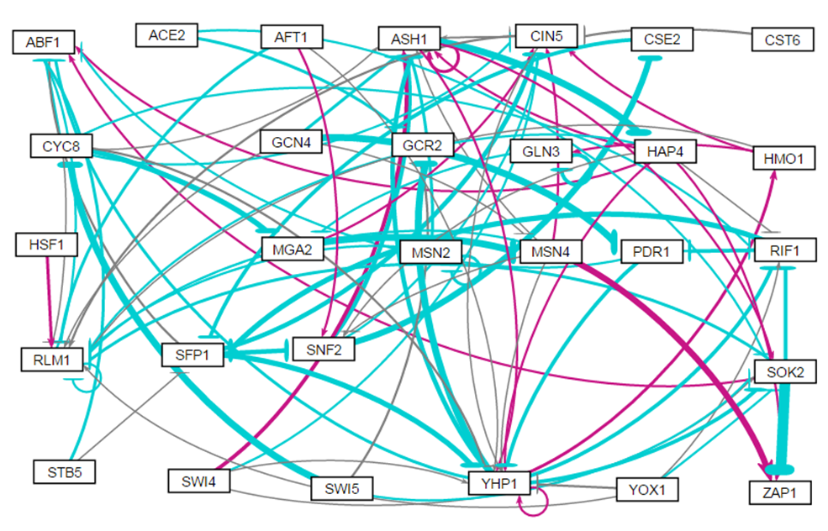
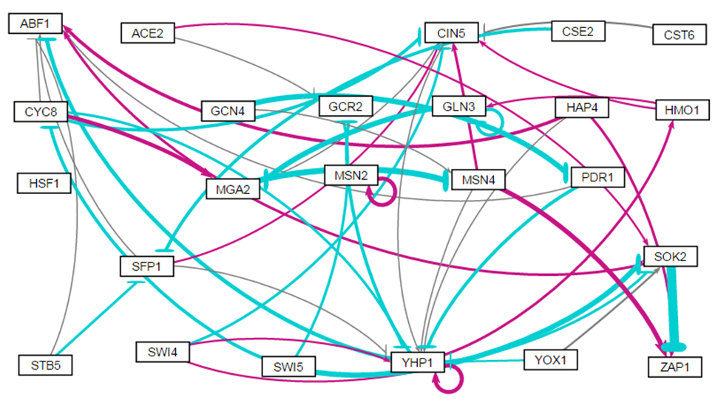
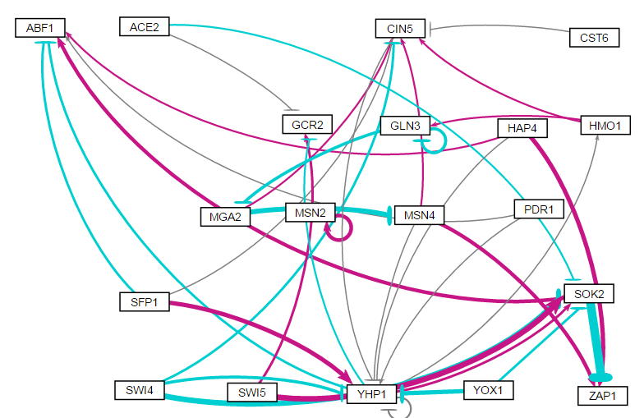
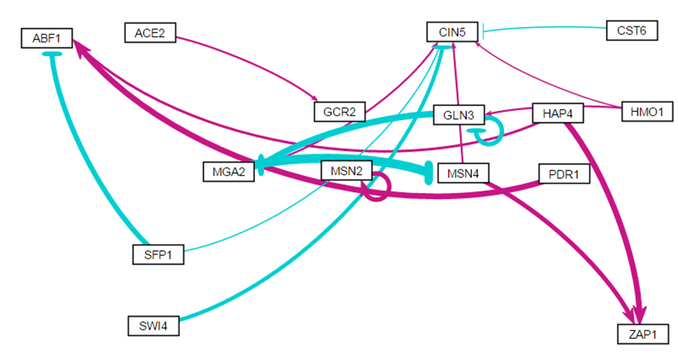
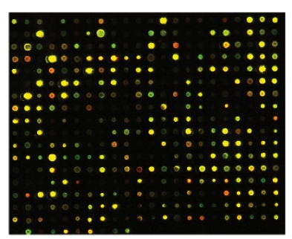

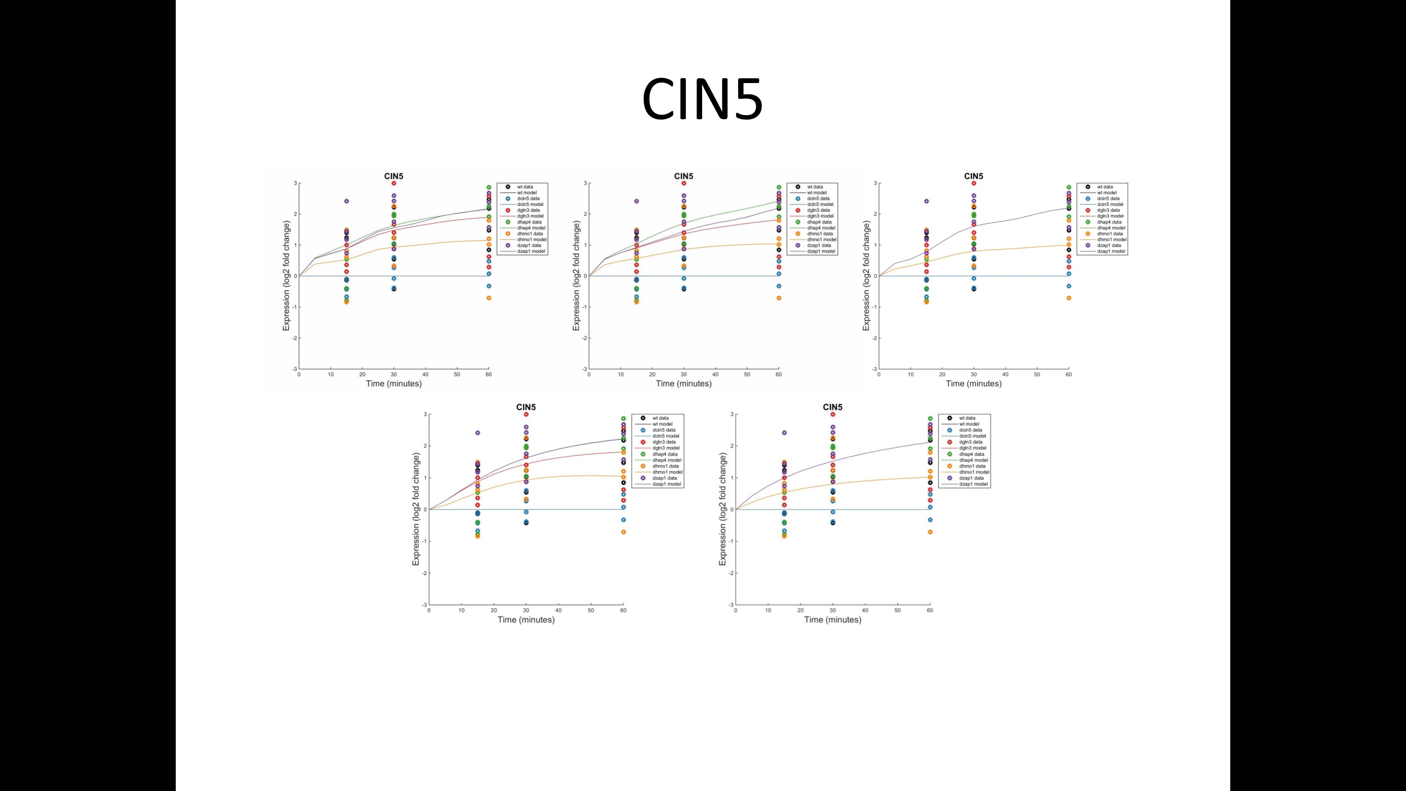
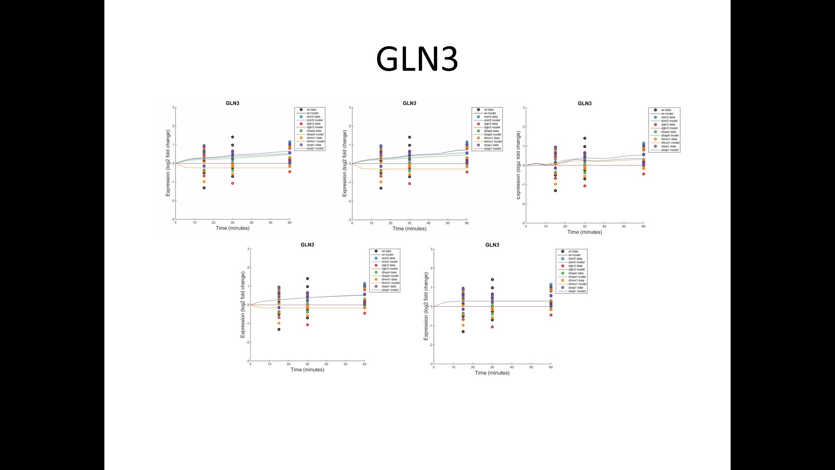
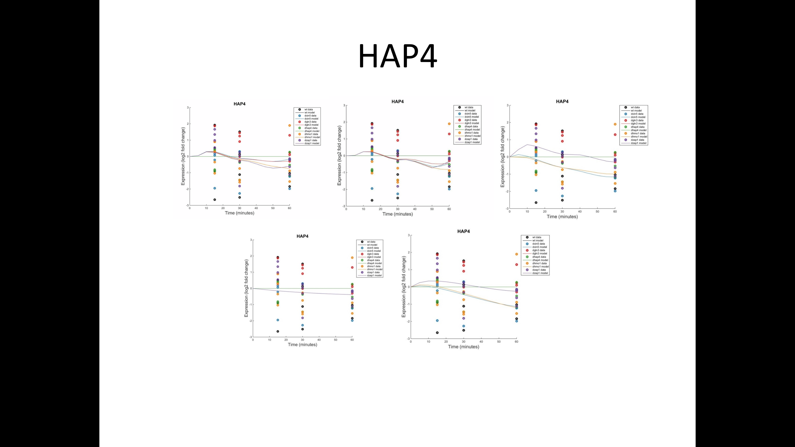
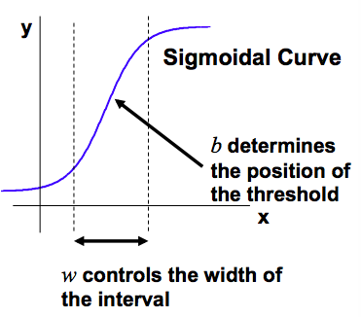
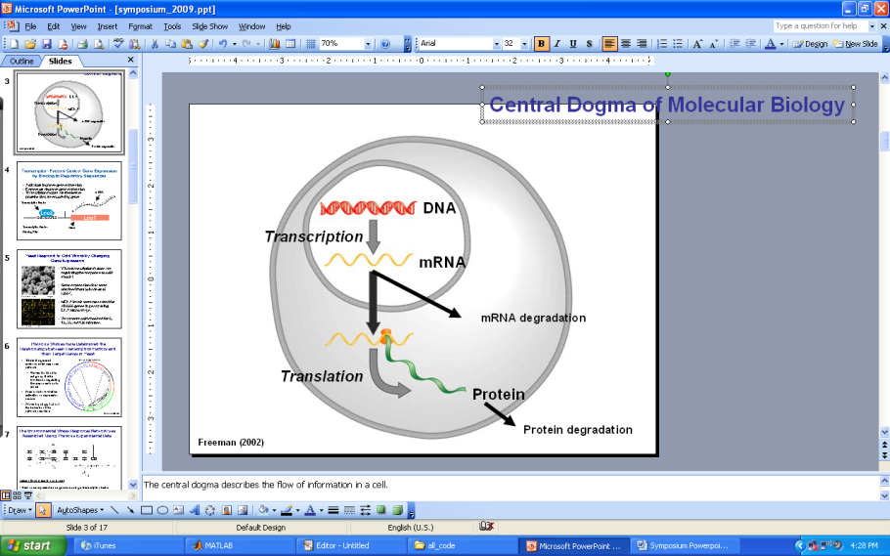
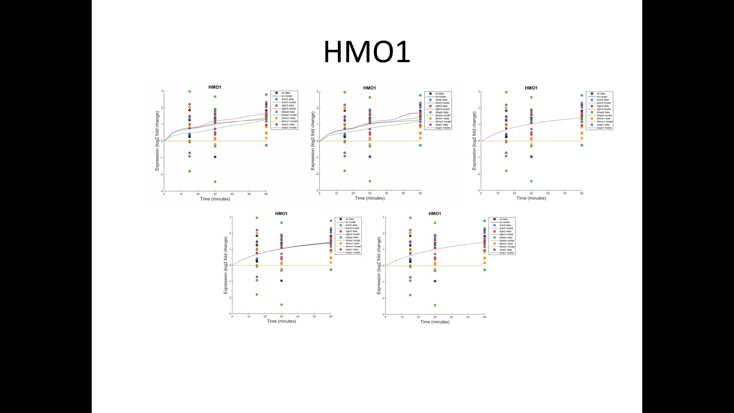
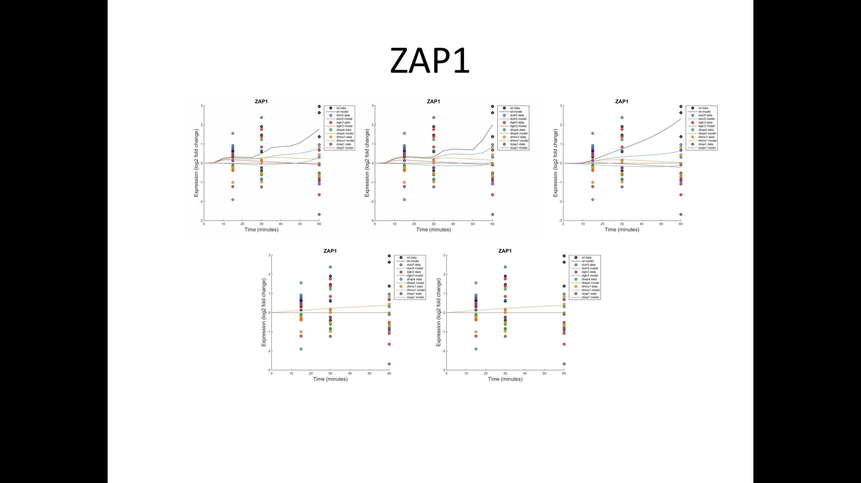
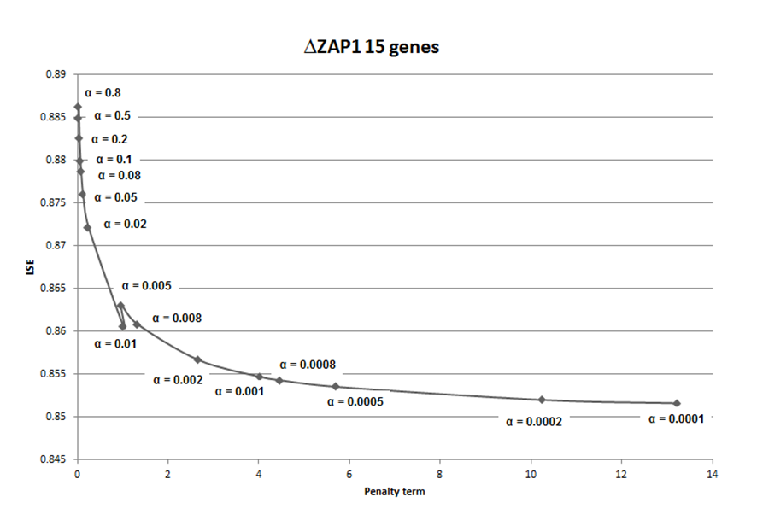
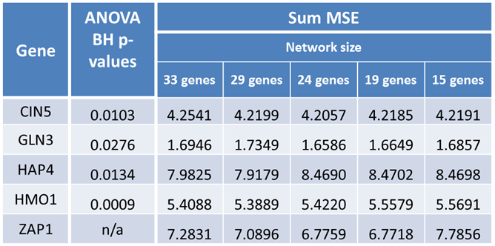
Mathematical Modeling Reveals Zap1's Role in the Gene Regulatory Network that Controls
the Response to Cold Shock in Saccharomyces cerevisiae
Kristen M. Horstmann¹, Tessa A. Morris², Brandon J. Klein¹, Kam D. Dahlquist¹, and Ben G. Fitzpatrick²
¹Department of Biology, ²Department of Mathematics
Loyola Marymount University, 1 LMU Drive, Los Angeles, CA 90045 USA
Gene Expression is Controlled by Regulatory Transcription Factors
Visualization of Five Networks with Weighted Edges Based on the Optimized w Parameter
Activators increase gene expression, while repressors decrease gene expression.
Transcription factors themselves are proteins that are encoded by genes.
A gene regulatory network (GRN) consists of a set of transcription factors that regulate the level of expression of a set of target genes, which can include other transcription factors.
The dynamics of a GRN is how the expression of genes in the network change over time.
33 Genes, 98 Edges
29 Genes, 88 Edges
24 Genes, 46 Edges
19 Genes, 36 Edges
15 Genes, 28 Edges
Yeast Respond to the Environmental Stress of Cold Shock by Changing Gene Expression
GRNsight automatically generates weighted network graphs from the output spreadsheets produced by GRNmap.
The absolute value of the individual weight parameters are divided by the largest value, which distributes them on a linear scale between 0 and 1; the thin lines have values near 0 while the thick lines have values near 1.
Positive weights are colored magenta to indicate activation, and negative weights are colored cyan to indicate repression.
Weights within +/- 0.05 of zero are colored grey to indicate a negligible influence on the target gene.
Little is known about which transcription factors regulate the response to cold shock.
The Dahlquist Lab has studied the transcriptional response to cold shock using DNA microarrays, which measure the level of mRNA expression for all 6000 genes in yeast.
Expression data was collected from the wild type and five transcription factor deletion strains (Δcin5, Δgln3, Δhap4, Δhmo1, and Δzap1) before cold shock (30°C) and after 15, 30, and 60 minutes of cold shock (13°C).
Mathematical modeling is then used to determine the relative influence of each transcription factor in the GRN that controls cold shock response.
In-Degree and Out-Degree Distributions for All Five Networks
Microarray at 60 minutes after cold shock
In- and out-degree distributions were plotted for all five networks. These plots show how many genes either regulate (out) or are being regulated (in) other genes in the network.
It makes sense that the fewest number of connections would occur most frequently, because the majority of the transcription factors have a small number of connections to genes in the rest of the network.
The high in-degree outliers occurred mostly for ASH1 and YHP1 for the larger networks and CIN5 for the smaller networks.
The Δzap1 Strain Microarray Data Was Used to Generate a Family of Related GRNs from the YEASTRACT Database
Least squares error (LSE) and minimum least squares error (MSE)
Parameter comparison charts for threshold b, production rates, and network weights
An ANOVA test of the DNA microarray data of the Zap1 deletion strain showed that 1859 genes (30%) had a log₂ fold change significantly different than zero at any time point for Benjamini and Hochberg corrected p < 0.05.
This list of genes was submitted to the YEASTRACT database, which outputted their potential regulatory transcription factors in order of significance.
A family of several gene regulatory networks was created. The deletion strain transcription factors (Cin5, Gln3, Hap4, and Hmo1) were added to 29 of the most significant regulators (which included Zap1) to generate the largest GRN. This network was pared down one-by-one by removing genes and edges in order of increasing significance to 15 transcriptional factors.
These are considered “medium-scale” networks as they represent only a small subset of the yeast genome’s approximately 250 transcription factors.
The number of parameters per network is equal to twice the number of nodes plus the number of edges (P + b + w). This accounts for the estimation of production rates, threshold b’s, and the weight parameters.
The least squares error (LSE) represents the difference between the simulated and actual data for all strains. The larger the LSE, the more difficult it was to fit the model to the data.
The minimum LSE would be the best theoretical model fit for each network based on the average of all the strain experimental data.
The ratio is the LSE divided by the minimum theoretical LSE and shows how close the LSE is to the ideal minimum LSE.
As the ratios were relatively similar for all five networks, this indicates the model performs consistently for a range of network sizes.
A Nonlinear Differential Equation Determines the Rate
at Which Each Gene is Expressed
While the the threshold b parameter values were similar for most genes no matter the network size, it changed dramatically when f key nodes and edges were removed from smaller networks.
Production rates for genes in the two largest networks are much larger than the three smaller networks, although some genes (ABF1, CST6, SWI4) have consistent production rates for all networks.
The change in sign for some edges seem to have resulted from the removal of edges in the smaller networks, for example,
ACE2->GCR2.
The model, called GRNmap (Gene Regulatory Network modeling and parameter estimation) was implemented in MATLAB (Dahlquist et al. 2015).
MATLAB code and executable are available under an open source license at http://github.com/kdahlquist/GRNmap/.
Expression Plots Show How Well the Model Fits the Data for Individual Transcription Factors
Conclusions and Future Directions
Each gene has a ordinary differential equation which models the change in expression over time measured as production minus degradation.
A sigmoidal production function is used where:
P_{i} is mRNA production rate for gene i
d_{i} is the mRNA degradation rate for gene i
w is weight term, determining the level of activation or repression of gene j on i
b is a unique threshold for each gene
The production rate (P_{i} ), weight (w ), and threshold (b) values were estimated from DNA microarray data using a penalized least squares approach:
The cold shock microarray data for the ZAP1 deletion strain was analyzed with an ANOVA statistic, the YEASTRACT database, and an ordinary differential equations model in order to model the change in expression of each gene over time. Five gene regulatory networks were generated of 33, 29, 24, 19, and 15 genes. These networks yielded optimized weight, threshold, and production rate parameters using a sigmoidal production function.
The output was visualized through GRNsight with weights, displaying activation and repression relationships between transcription factors.
The in and out degree distribution frequencies showed that ASH1, YHP1, and CIN5 had the most connections in the networks studied.
The actual LSE to minimum theoretical LSE ratio demonstrated the model works consistently for this range of network sizes. The parameter comparisons show how the parameters can change with the removal of nodes and edges from the networks.
Expression plots showed that the model fit the smaller networks better than the larger ones, which may have been due to the smaller number of parameters being estimated.
From the sum MSE’s, it was found that the genes that have inputs are modeled more accurately than those that have only outputs.
In addition to production rates, threshold b, and weight parameters, GRNmap also outputs expression plots for each gene, as shown for the five deletion strains.
From left to right and by row, the plots shown are for the 33 gene network, down to the 15 gene network.
The points are the experimental data for each gene, while the lines are the simulated data from forward simulation of the model.
The genes chosen to examine further are the deletion strains, as we are most interested in how well the model works with these strains.
The larger networks had less accurate and more sporadic fits to the data, whereas the smaller networks showed smoother curves.
(Freeman, 2002)
In the future, the causes of the anomalies with the L-curve analysis and production rates will be investigated and fixed, if necessary.
Comparison with model runs of random networks with the same number of nodes and randomized edges will be important to determine if the goodness of fit of the dynamics depend entirely on just the sheer number of nodes and edges, or on the biological validity of the connections.
E represents the error between estimated values and microarray data values.
Θ is the penalty term of combined w, P, and b parameter values
L-curve Analysis Suggested a Good Alpha Value to be 0.002
Acknowledgments
L-curve for 15 Gene, 28 Edge Network
The estimation was run iteratively for alpha values ranging from 0.8 down to 0.0005.
Parameter outputs from one run were used as the initial estimates for the next run. Least Squares Error (LSE) was plotted against the penalty term for each alpha value.
The ideal alpha value minimizes both the LSE and penalty term, and therefore lies near the “elbow” of the L-curve.
Therefore, 0.002 was chosen and used for further runs of the model.
For their work on the GRNmap code, we would like to thank Juan S. Carrillo, Trixie Anne M. Roque, Chukwuemeka E. Azinge, Katrina Sherbina, and Nicholas A. Rohacz. We thank Nicole A. Anguiano, Anindita Varshneya, Mihir Samdarshi, and Britain J. Southwick for their work on the GRNsight visualization software. Microarray data were collected by Cybele Arsan, Wesley Citti, Kevin Entzminger, Andrew Herman, Monica Hong, Heather King, Lauren Kubeck, Stephanie Kuelbs, Elizabeth Liu, Matthew Mejia, Kevin McGee, Kenny Rodriguez, Olivia Sakhon, Alondra Vega, and Kevin Wyllie. This work was supported by NSF-RUI Award 0921038 (K.D.D., B.G.F.), a Kadner-Pitts Research Grant (K.D.D.), and the Rains Research Assistant Program (T.A.M.).
ANOVA p values and Mean Squared Errors for Individual Genes Explain the Goodness of Fit
References
The ANOVA test shows whether each gene showed a significant change in expression at any of the time points (Benjamini & Hochberg corrected p < 0.05).
Mean squared errors (MSE) shows the goodness of fit of the simulated data to the experimented data for individual genes.
GLN3 has the smallest error and HAP4 has the largest.
This can likely be attributed to HAP4 only having no inputs, which is the main way that the model would control the transcription factor.
It is possible that the model works well when an individual gene has significant dynamics, but does not work as well when the genes are not changing expression.
Belle, A., Tanay, A., Bitincka, L., Shamir, R., & O’Shea, E. K. (2006). Quantification of protein half-lives in the budding yeast proteome.Proceedings of the National Academy of Sciences, 103(35), 13004-13009.
Dahlquist, K., Fitzpatrick, B., Camacho, E., Entzminger, S., & Wanner, N. (2015). Parameter Estimation for Gene Regulatory Networks from Microarray Data: Cold Shock Response in Saccharomyces cerevisiae. Bulletin Of Mathematical Biology, 77(8), 1457-1492. http://dx.doi.org/10.1007/s11538-015-0092-6.
Dário Abdulrehman, Pedro T. Monteiro, Miguel C. Teixeira, Nuno P. Mira, Artur B. Lourenço, Sandra C. dos Santos, Tânia R. Cabrito, Alexandre P. Francisco, Sara C. Madeira, Ricardo S. Aires, Arlindo L. Oliveira, Isabel Sá-Correia, Ana T. Freitas (2011). YEASTRACT: providing a programmatic access to curated transcriptional regulatory associations in Saccharomyces cerevisiae through a web services interface Nucl. Acids Res., 39: D136-D140, Oxford University Press.
Freeman, S. (2002). Biological science. Upper Saddle River, NJ: Prentice Hall.
GRNsightt. (n.d.). Retrieved March 10, 2016, from http://dondi.github.io/GRNsight/
GRNmap. (n.d.). Retrieved March 10, 2016, from https://github.com/kdahlquist/GRNmap
Degree distribution charts

